Slide 1
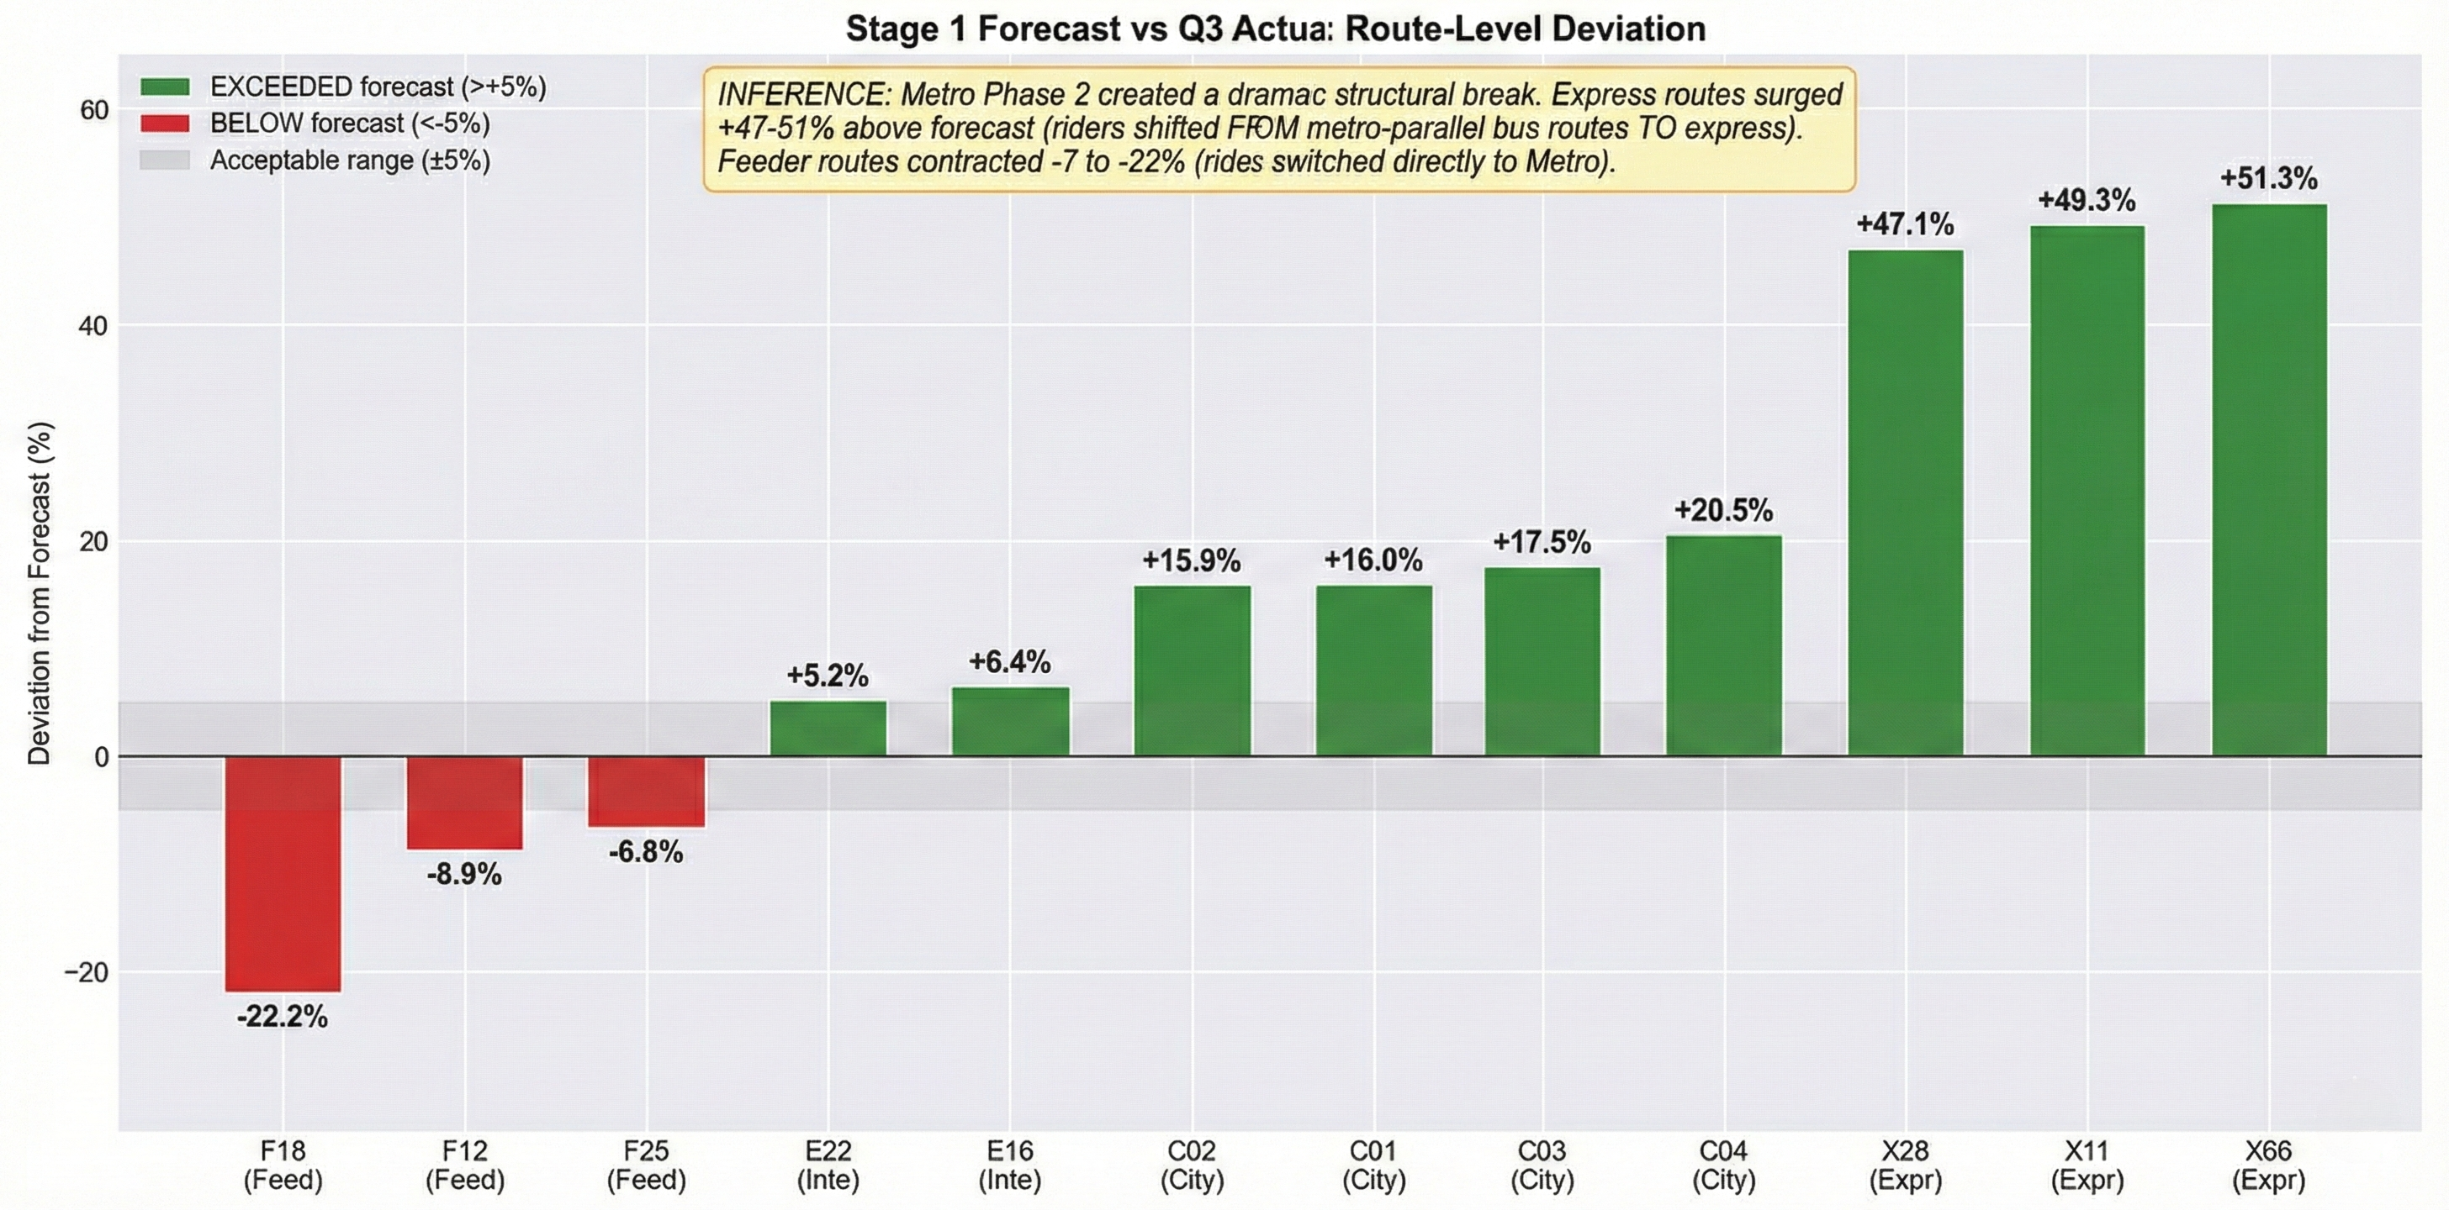
Shock Diagnosis - Metro Phase 2 — Structural Break Detection
Route | Type | Deviation
X66 | Express | +51.3%
X11 | Express | +49.3%
X28 | Express | +47.1%
C04 | City | +20.5%
F18 | Feeder | -22.2%
F12 | Feeder | -8.9%
Shift Type | Finding | Magnitude
Level | Express ↑, Feeder ↓ | +29-32% / -18-31%
Volatility | All routes LOWER CV | -2 to -18%
Elasticity | Congestion sensitivity 2× | +101%
Congestion | Higher despite metro | +10.9%
l
STRUCTURAL BREAK: +16.1%
Q3 actual exceeded Stage 1 forecast by 402,832 passengers
Classification: REGIME CHANGE (not temporary shock)

Slide 2
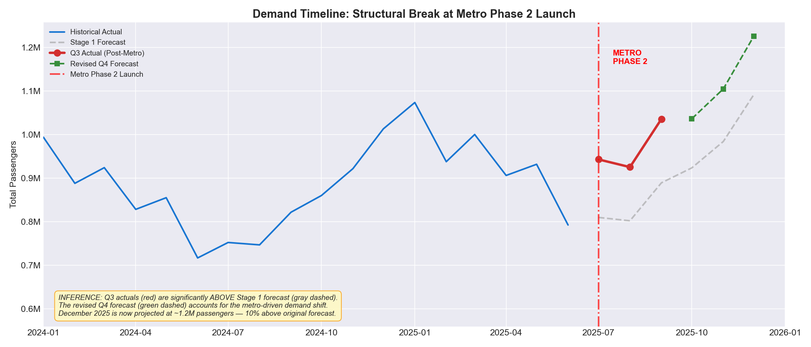
SLIDE 2: Model Recalibration Summary
Stage 1 → Stage 2 Forecast Revision
Recalibration Methodology
1. Compute Q3 forecast-vs-actual deviation per route
2. Classify: Stable (<5%) | Moderate (5-15%) | Regime (>15%)
3. Apply adjustment: 75% permanent for regime, 50% for moderate
Metric | Stage 1 | Stage 2 | Change
Q4 Total | 2,999,357 | 3,366,963 | +12.3%
Uncertainty | ±5% | ±23.6% | 4.7× wider
Full-Year 2025 | 11,142,733 | 11,910,399 | +6.9%
Route | Type | Classification | Factor | Q4 Change
X66 | Express | Regime Change | 1.385 | +38.5%
X11 | Express | Regime Change | 1.370 | +37.0%
X28 | Express | Regime Change | 1.353 | +35.3%
C04 | City | Regime Change | 1.154 | +15.4%
F18 | Feeder | Regime Change | 0.834 | -16.6%
F12 | Feeder | Moderate Shift | 0.956 | -4.4%
⚡ Key: We separate temporary shock (25%) from permanent regime change (75%). The wider ±23.6% uncertainty reflects limited post-shock data (1 quarter only).
DECODE X 2026 | Stage 2 Structural Recalibration Brief
Slide 2 of 5

Slide 3
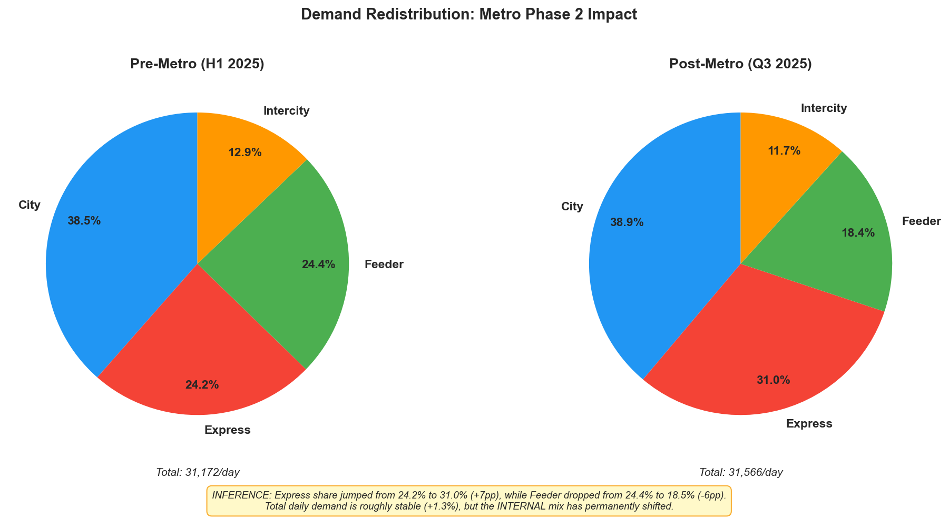
SLIDE 3: Impact Quantification
Before vs After Metro Phase 2
Metric | Pre-Metro (H1) | Post-Metro (Q3) | Change
Daily Demand | 31,172 | 31,566 | +1.3%
Express Share | 24.2% | 31.0% | +6.8pp
Feeder Share | 24.4% | 18.5% | -5.9pp
City Share | 38.5% | 38.9% | +0.4pp
Congestion | 2.78 | 3.09 | +10.9%
Bus Speed | 31.1 km/h | 29.2 km/h | -6.3%
Cong. Elasticity | +720 pax/lvl | +1,447 pax/lvl | +101%
Pax/km (network) | 144.0 | 146.1 | +1.5%
Route | Pre Pax/km | Post Pax/km | Change | Status
X28 (Exp) | 207 | 267 | +28.9% | 🔴 CRITICAL
X66 (Exp) | 123 | 163 | +32.2% | 🔴 OVERLOADED
X11 (Exp) | 113 | 145 | +28.6% | 🔴 OVERLOADED
F18 (Feed) | 150 | 103 | -31.2% | 📉 Contracting
F12 (Feed) | 88 | 70 | -20.2% | 📉 At Risk
🔑 Total demand barely changed (+1.3%). But internal mix shifted dramatically: Express +7pp, Feeder -6pp. This is a REDISTRIBUTION, not contraction — same passengers, different routes.
DECODE X 2026 | Stage 2 Structural Recalibration Brief
Slide 3 of 5

Slide 4
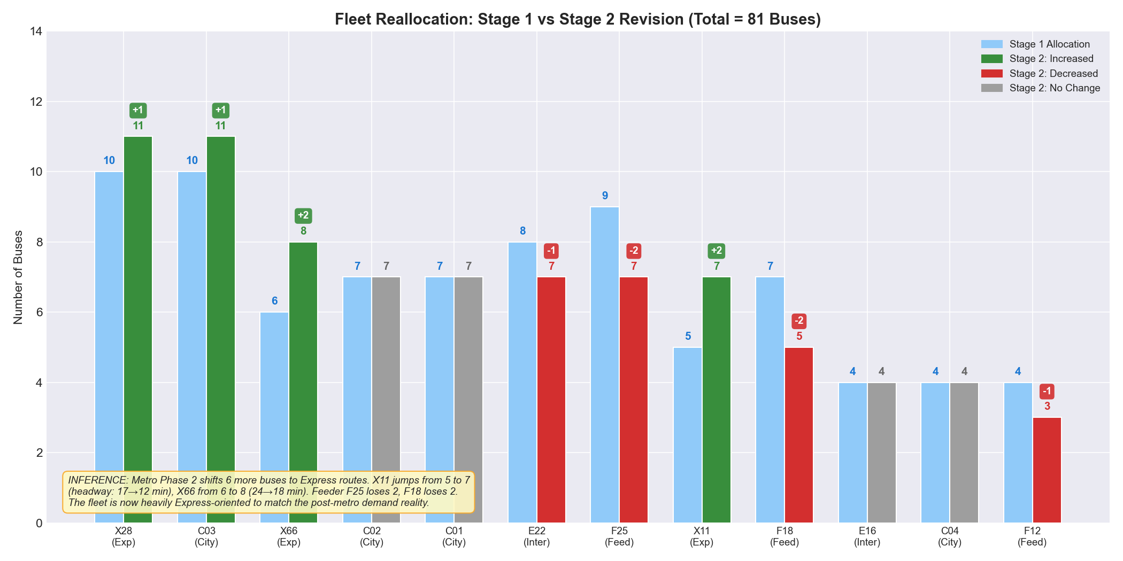
SLIDE 4: Trade-Off Identification
Budget-Neutral Reallocation vs Fleet Expansion
Trade-Off 1: Express Capacity vs Feeder Viability
Every bus moved to Express improves 3,300 riders' experience,
but degrades 1,800 Feeder riders' service.
Trade-Off 2: Headway vs Coverage
X28 headway: 20→11 min (38% better)
But C04: 20→35 min, F12: 20→44 min (barely viable)
Trade-Off 3: Speed vs Sustainability
Option | Speed | Cost | Duration
Reallocate only | Immediate | ₹0 | 60-90 days
Procure 8-10 buses | 60-90 days | ₹16-20 Cr | 12-18 months
Hybrid (recommended) | Both | ₹16-20 Cr | Best of both
⚠️ RECOMMENDATION: Hybrid approach — reallocate 11 buses immediately as a bridge measure, while initiating procurement of 8-10 new buses to reach Express corridors by November 2025 (Winter Peak).
X28 | X11 | X66 | C03 | C01 | C02 | C04 | E22 | E16 | F25 | F18 | F12
10→11 | 5→7 | 6→8 | 10→11 | 7→7 | 7→7 | 4→4 | 8→7 | 4→4 | 9→7 | 7→5 | 4→3
DECODE X 2026 | Stage 2 Structural Recalibration Brief
Slide 4 of 5

Slide 5
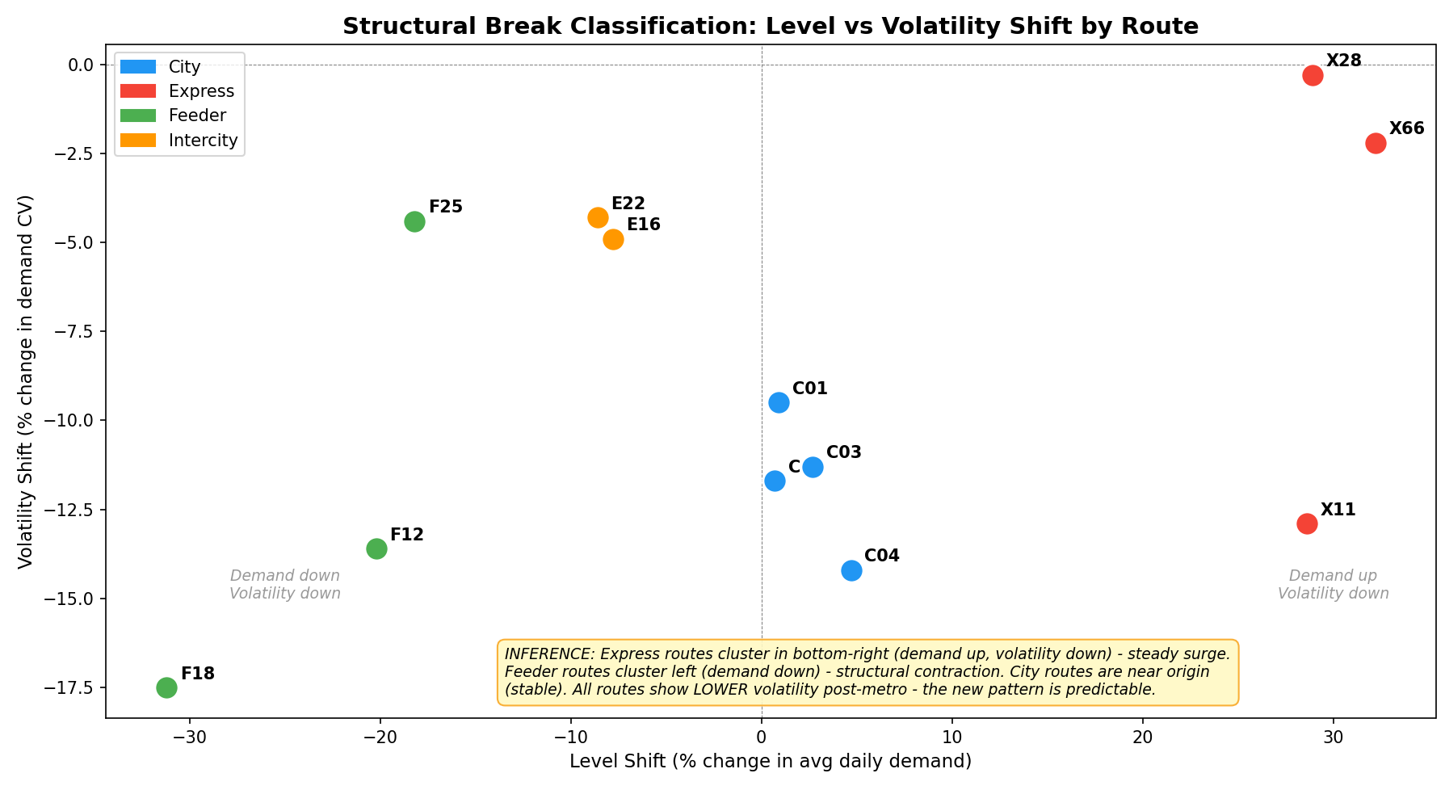
SLIDE 5: Stage 3 Optimization Direction
Not Final Answers — Strategic Direction
Axis 1: Feeder-Metro Integration
routes F18/F12 are structurally contracting.
Optimization direction: Restructure as metro-connector feeder routes.
Operational Guideline: Avoid parallel (180°) routes; align feeders perpendicular (90°) to metro lines to maximize unique catchment and passenger capture.
Key question: Which stops should become termini?
Axis 2: Express Corridor Scaling
All 3 Express routes at OVER-CAPACITY even after reallocation.
Optimization direction: Dedicated bus lanes + fleet expansion on X28 corridor.
Key question: Optimal Express fleet size for the new demand regime?
Axis 3: Dynamic Demand Management
Congestion elasticity doubled post-metro.
Optimization direction: Dynamic headway triggers deploying extra buses when congestion > Level 3
Key question: How many buses in dynamic reserve?
STAGE 3 THESIS: The challenge is not fighting the Metro shift . it's DESIGNING a bus network that complements the metro. Feeders must connect TO metro, not compete WITH it. Express must scale to absorb the redistributed demand. We are prepared to optimize this new equilibrium.
Slide 5 of 5

